Slide 1
STEPS I FOLLOWED TO ACHIEVE THIS PROJECT.
-L.SHASANK CHOWDARY

Slide 2
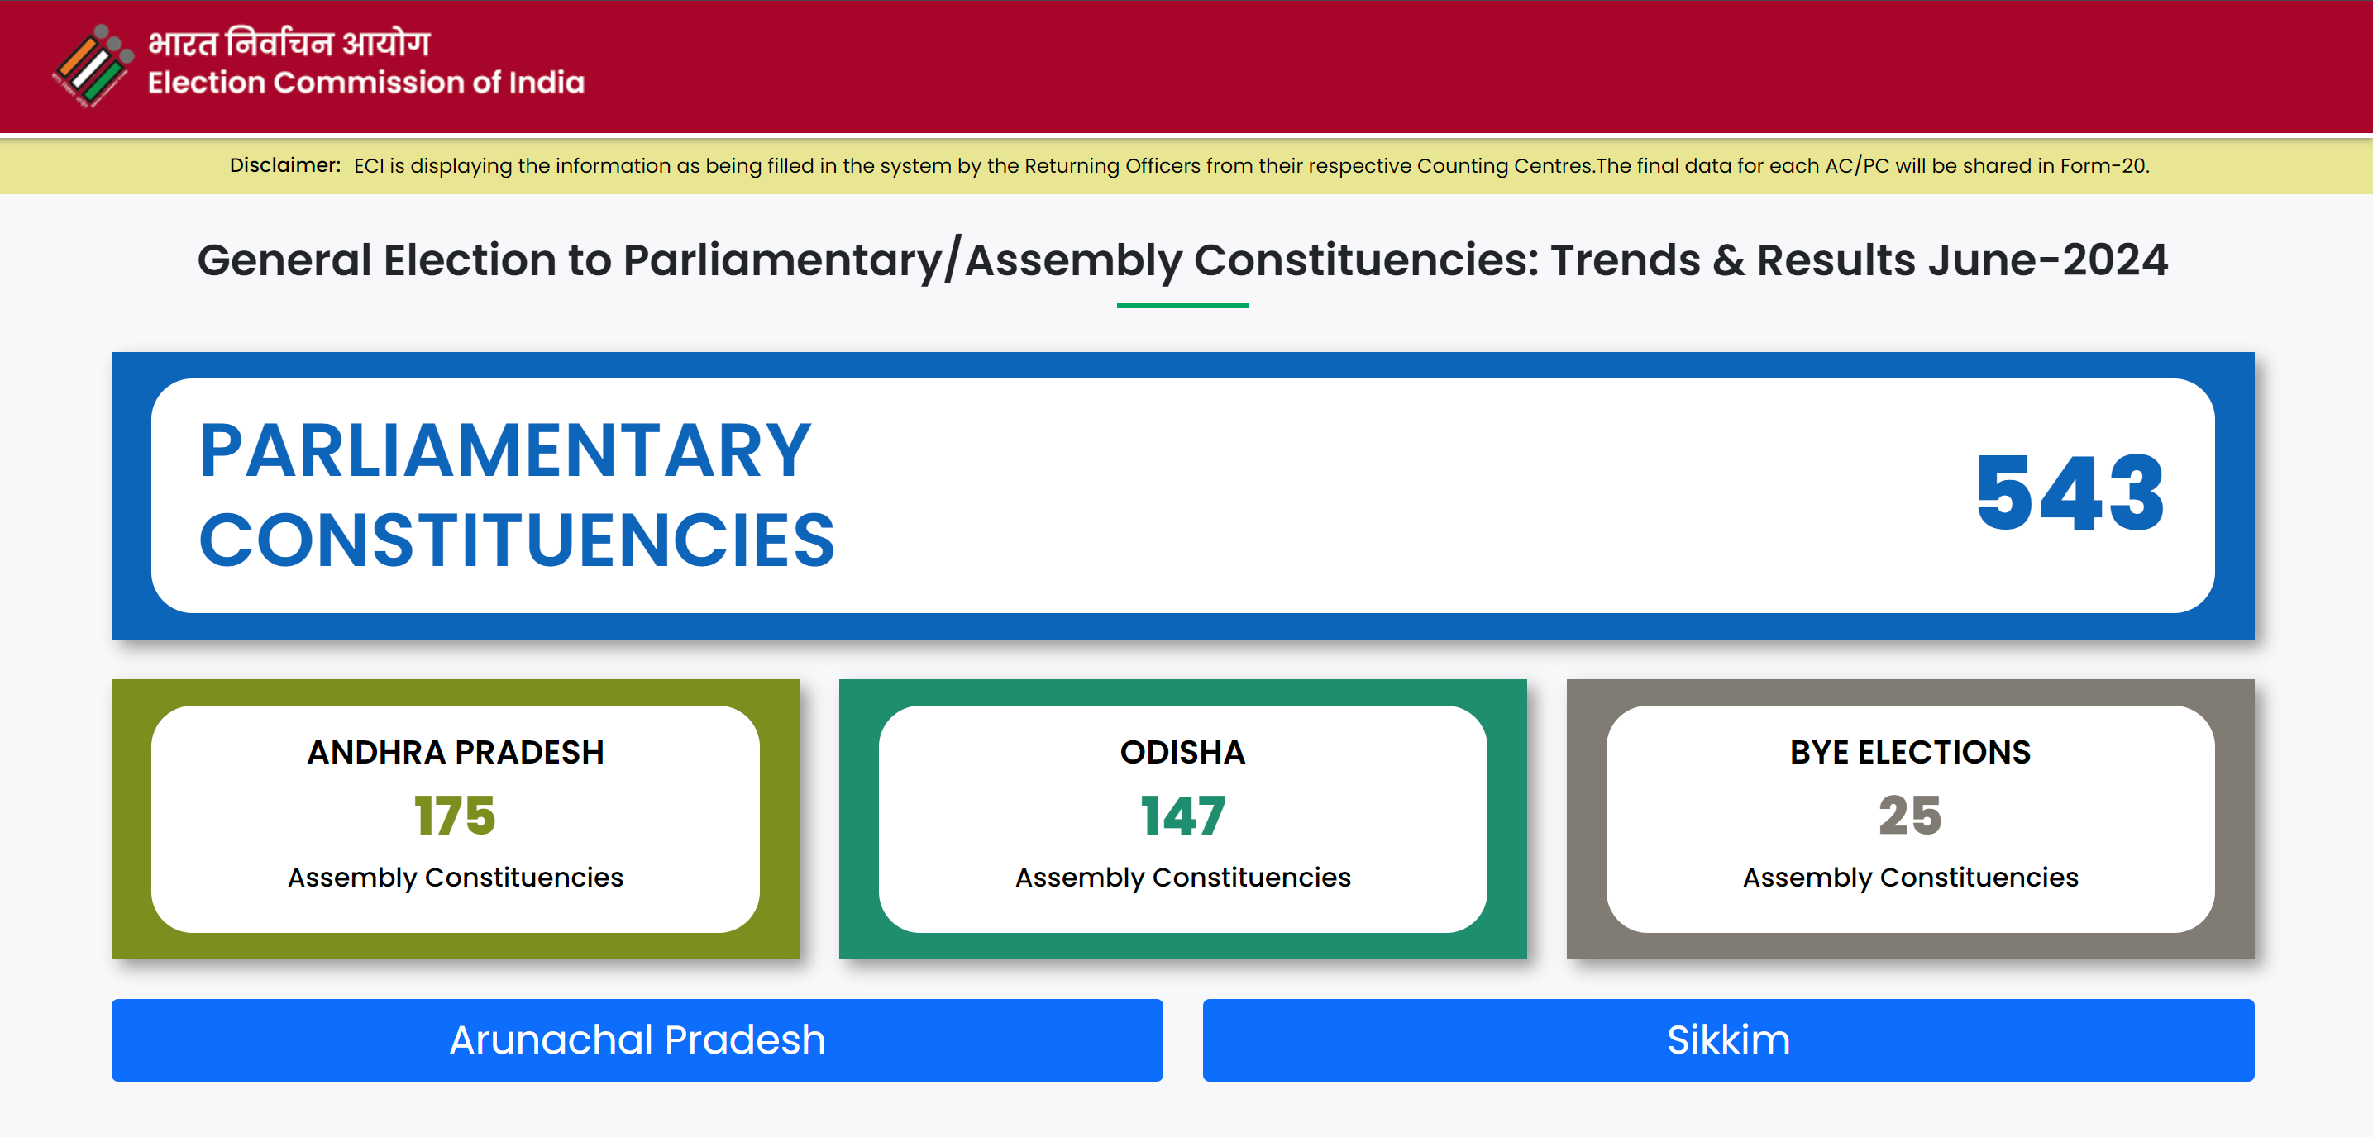
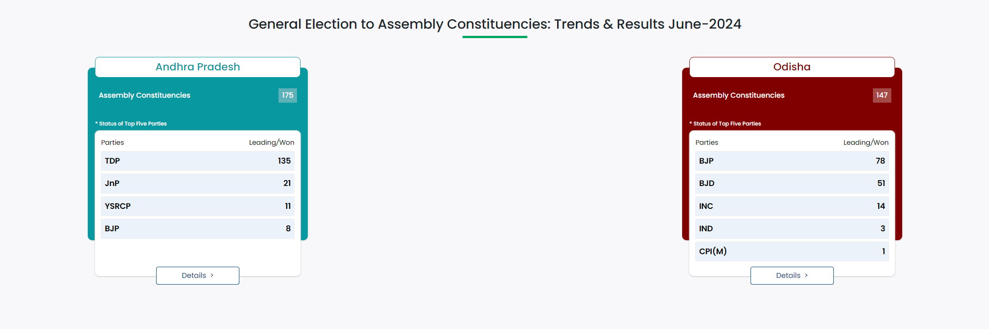
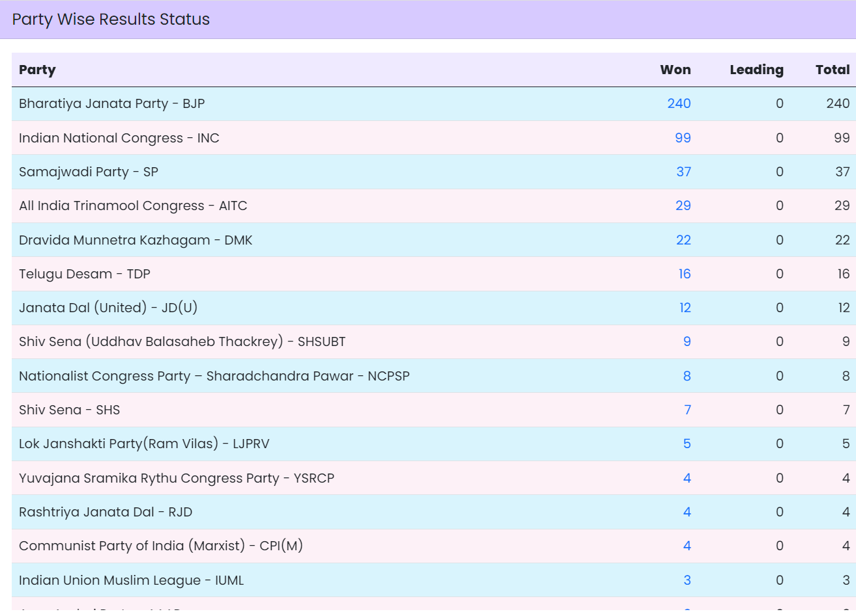
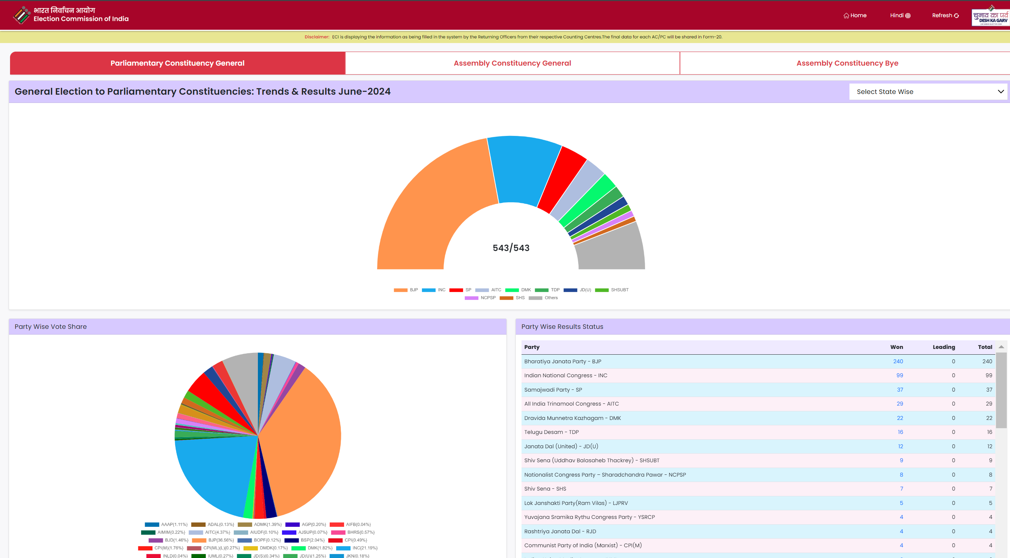
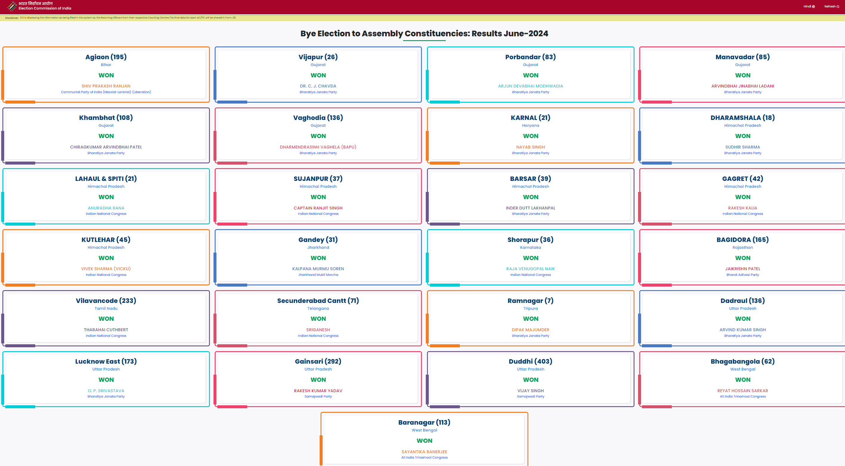
1.UNDERSTOOD THE DATA GIVEN

Slide 3
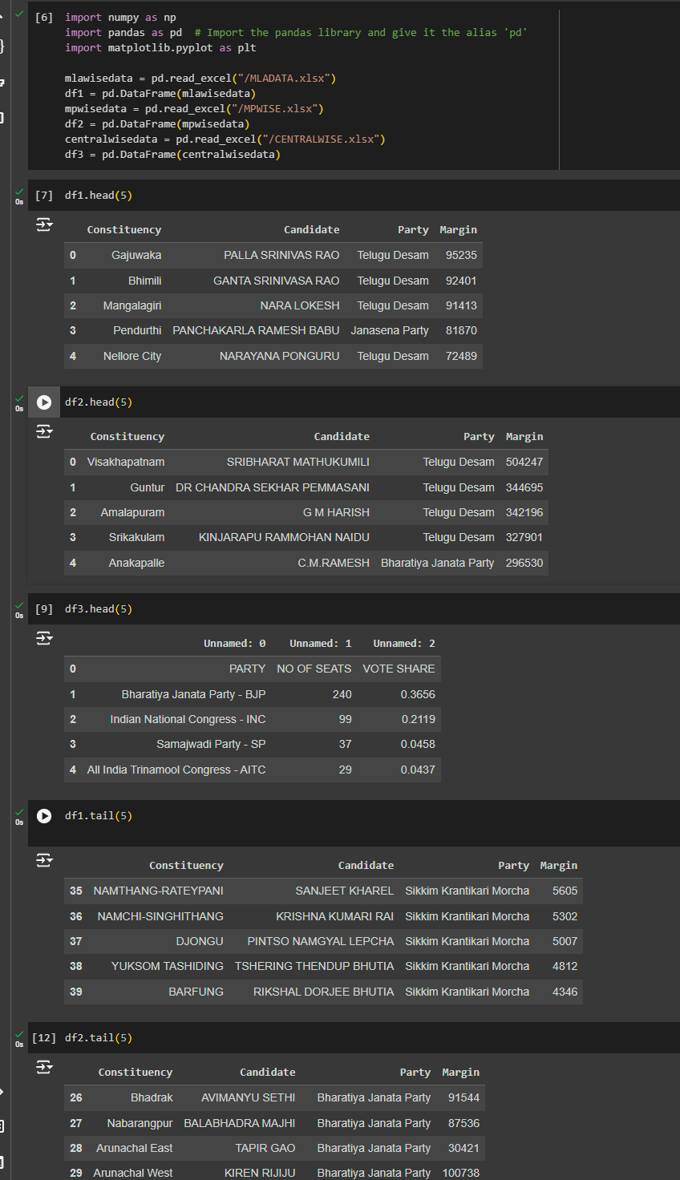
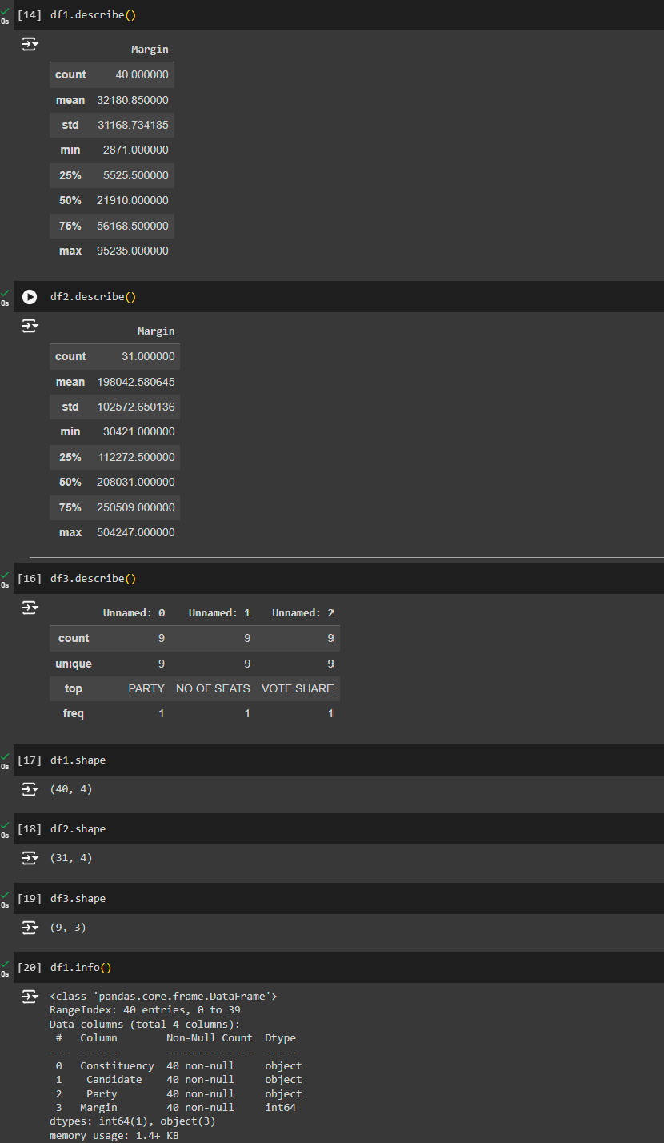
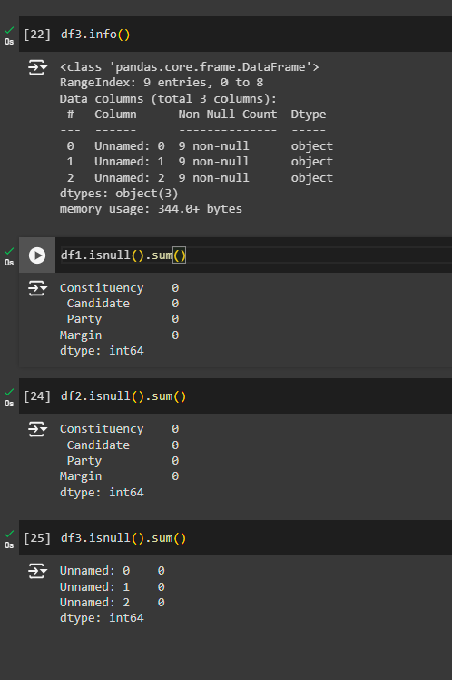
2.BASIC DATA ANALYSIS DONE BY EDA - PANDAS

Slide 4
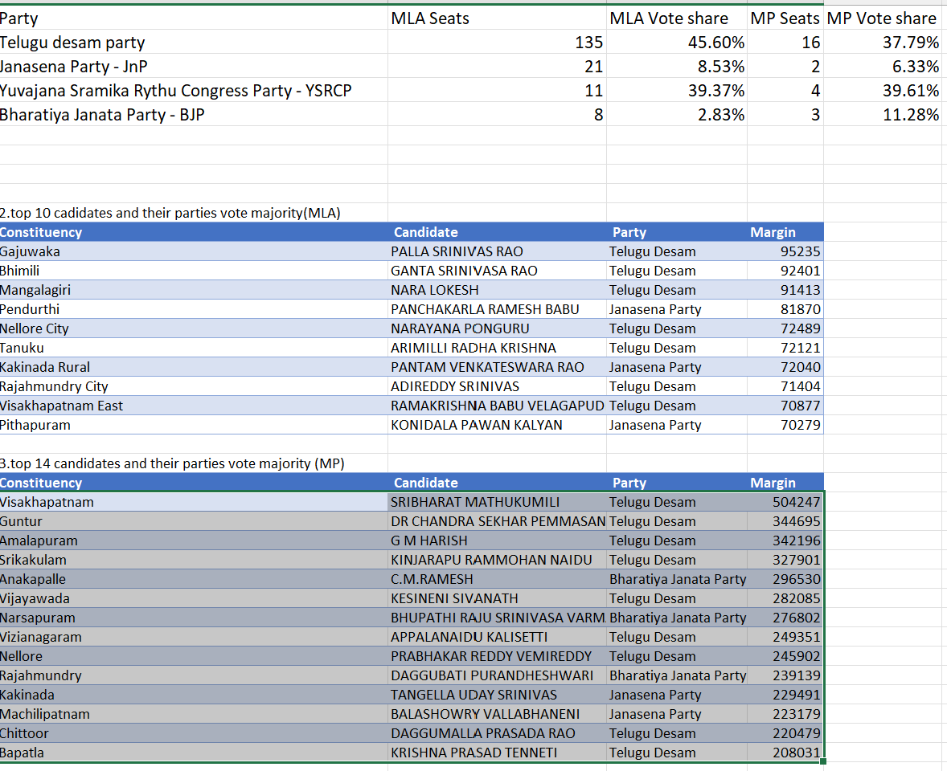
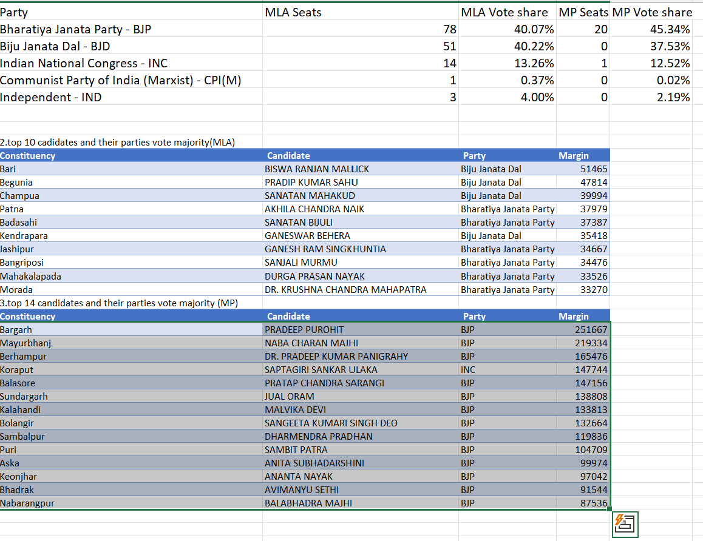
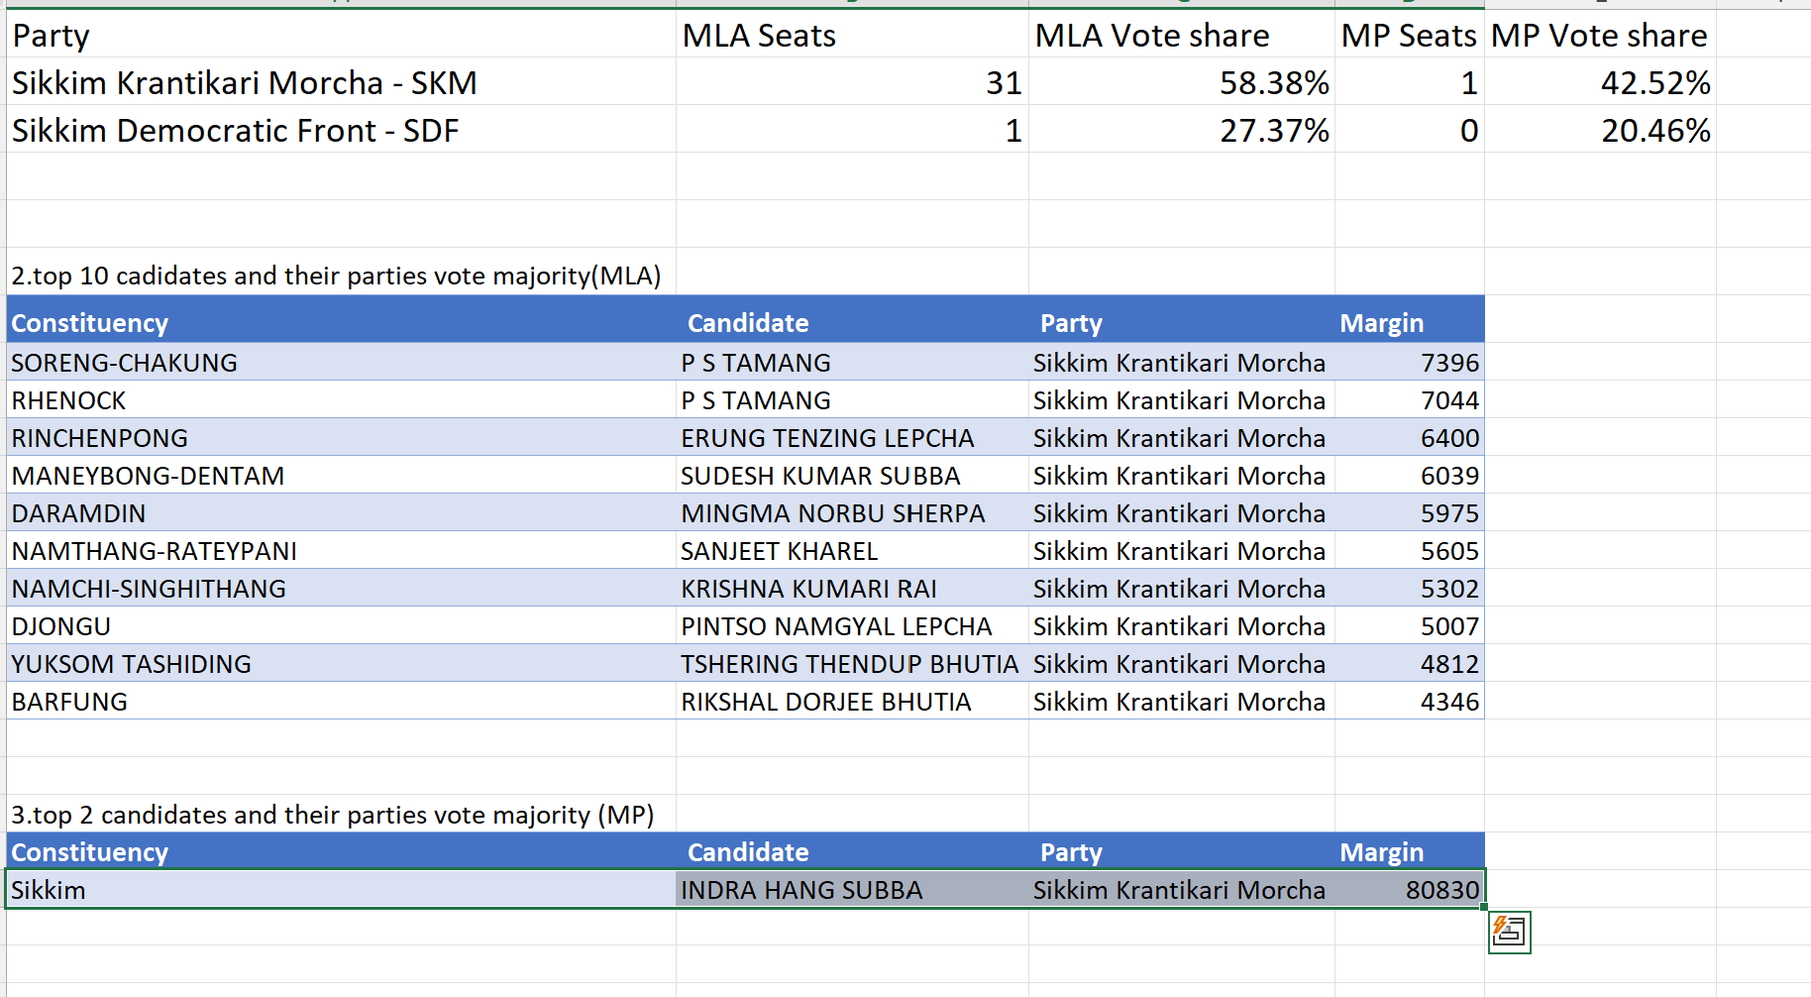
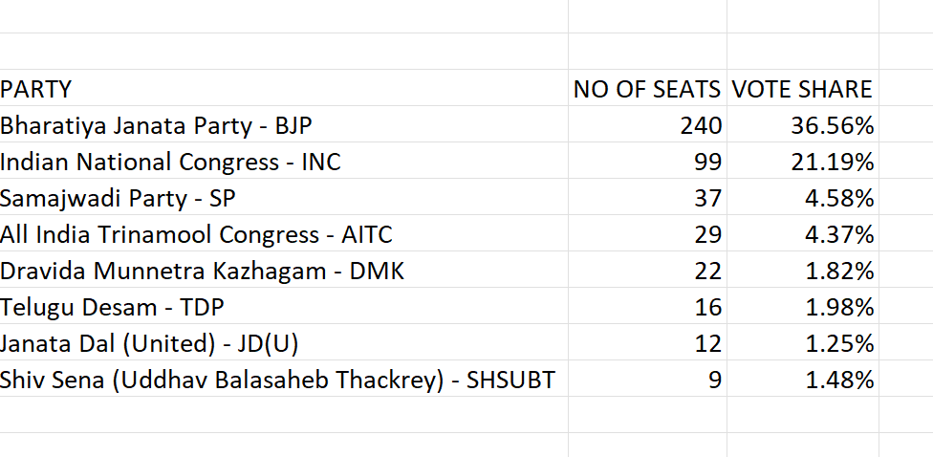
3.PREPARED TABLES IN M.S.EXCEL ACCORDINGLY.

Slide 5
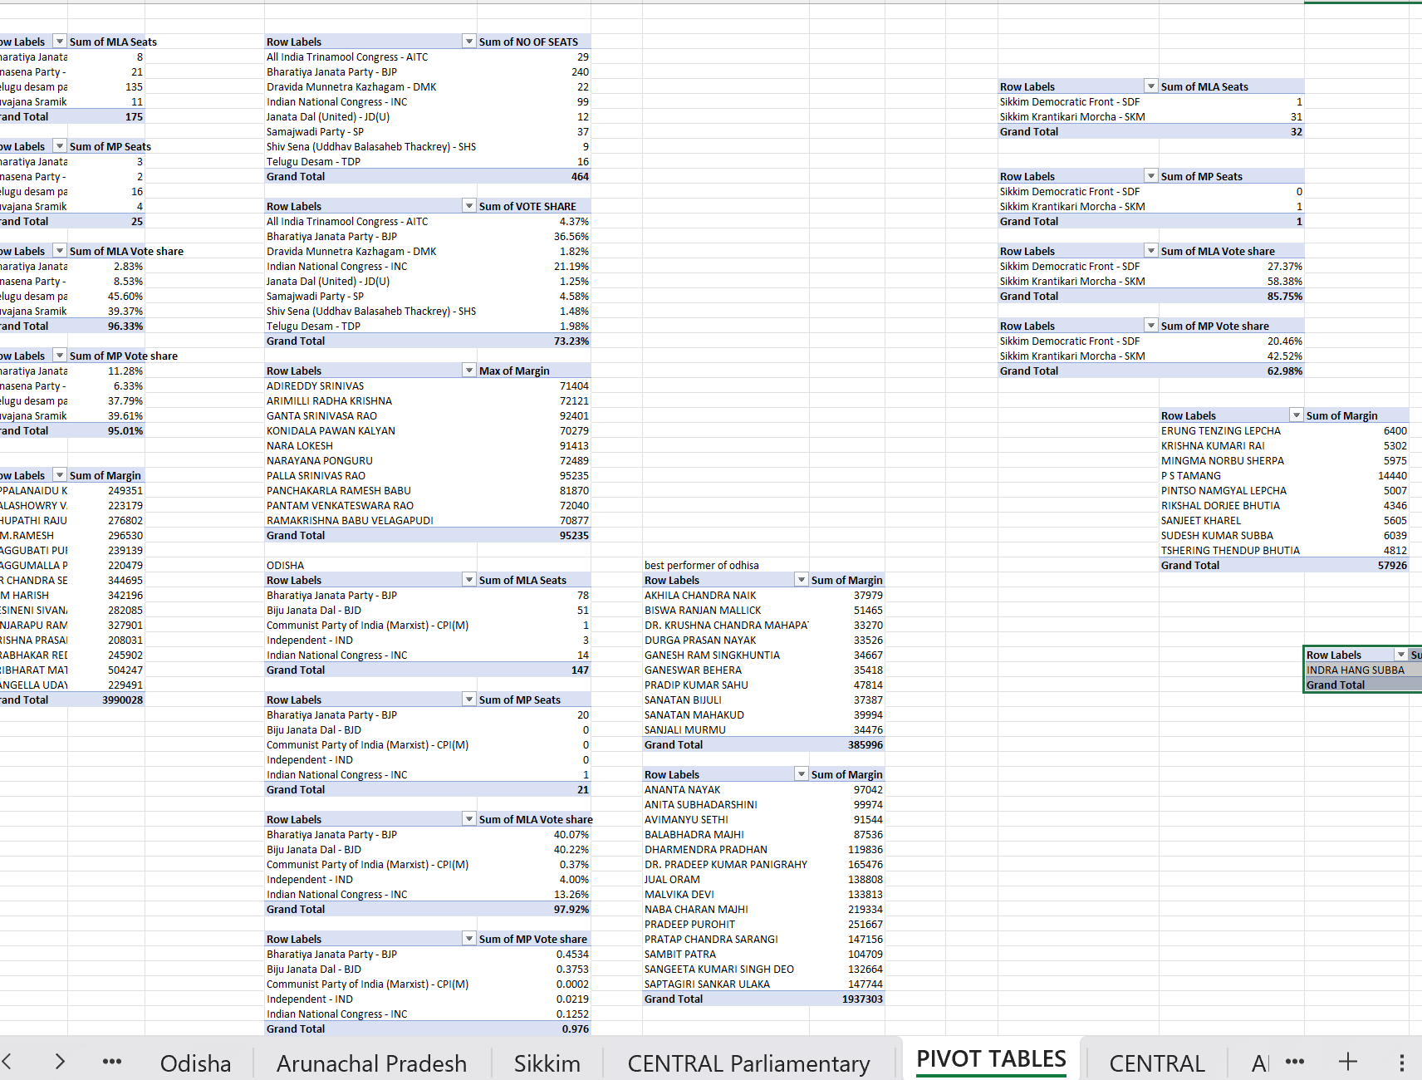
4.BY USING THESE TABLES ,I PREPARED PIVOT CHARTS

Slide 6
5.STRUCTURED 10 INSIGHTS TO ANALYZE THE DATA
STATE THE VOTE COUNT & VOTE SHARE IN PARLIAMENTARY CONSTITUENCY GENERAL.
ANALYSE THE ELECTIONS IN ANDHRA PRADESH VIA COMPARING MLA&MP SEATS.
STATE THE TOP% OF CANDIATES VIA MARGIN (MLA&MP) IN AP.
ANALYSE THE ELECTIONS IN ODISHA VIA COMPARING MLA&MP SEATS.
STATE THE TOP% OF CANDIATES VIA MARGIN (MLA&MP) IN ODISHA.
ANALYSE THE ELECTIONS IN ARUNACHAL PRADESH VIA COMPARING MLA&MP SEATS.
STATE THE TOP% OF CANDIATES VIA MARGIN (MLA&MP) IN ARUNACHAL PRADESH.

Slide 7
ANALYSE THE ELECTIONS IN SIKKIM VIA COMPARING MLA&MP SEATS.
STATE THE TOP% OF CANDIATES VIA MARGIN (MLA&MP) IN SIKKIM.
INSIGHTS ABOUT BY-ELECTIONS IN 2024.

Slide 8
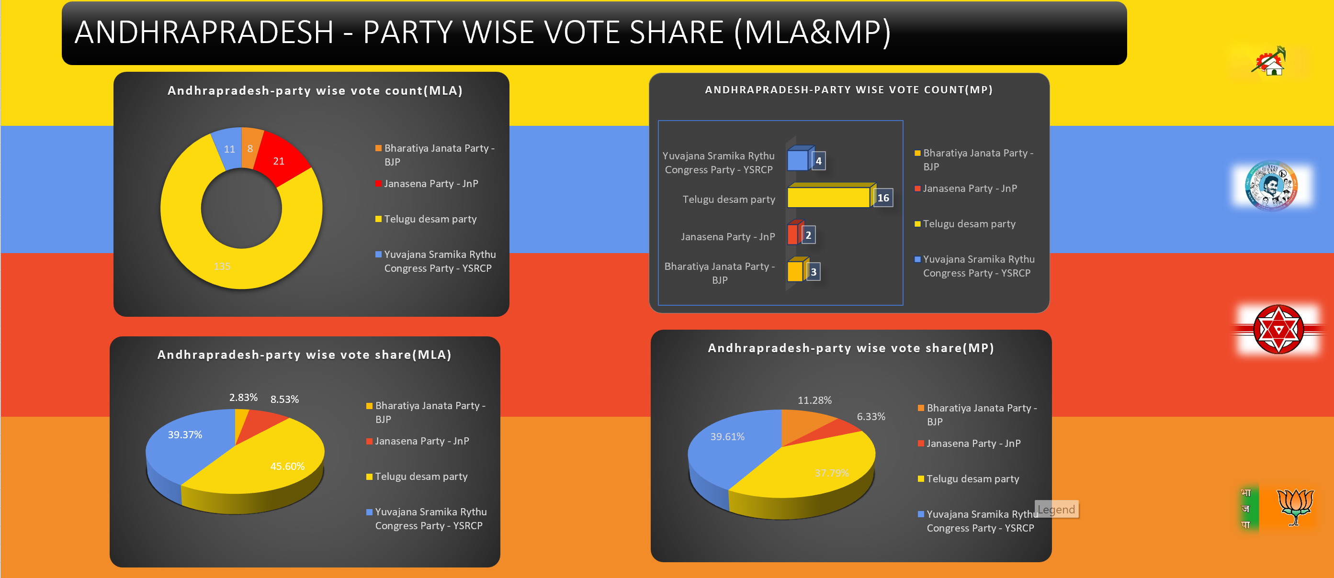
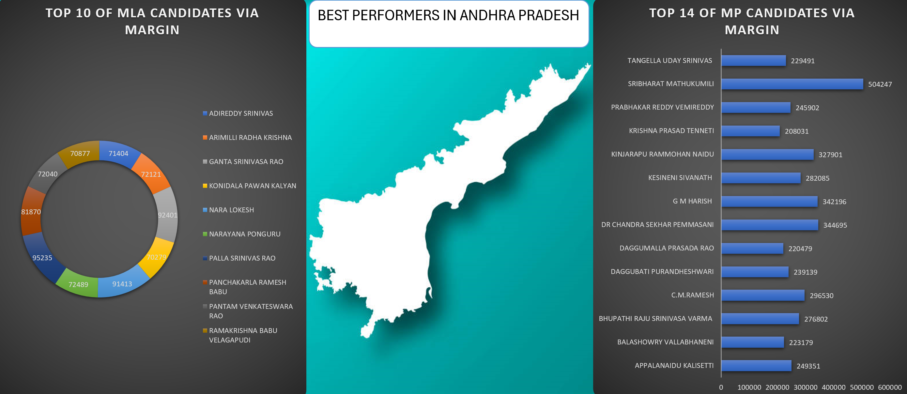
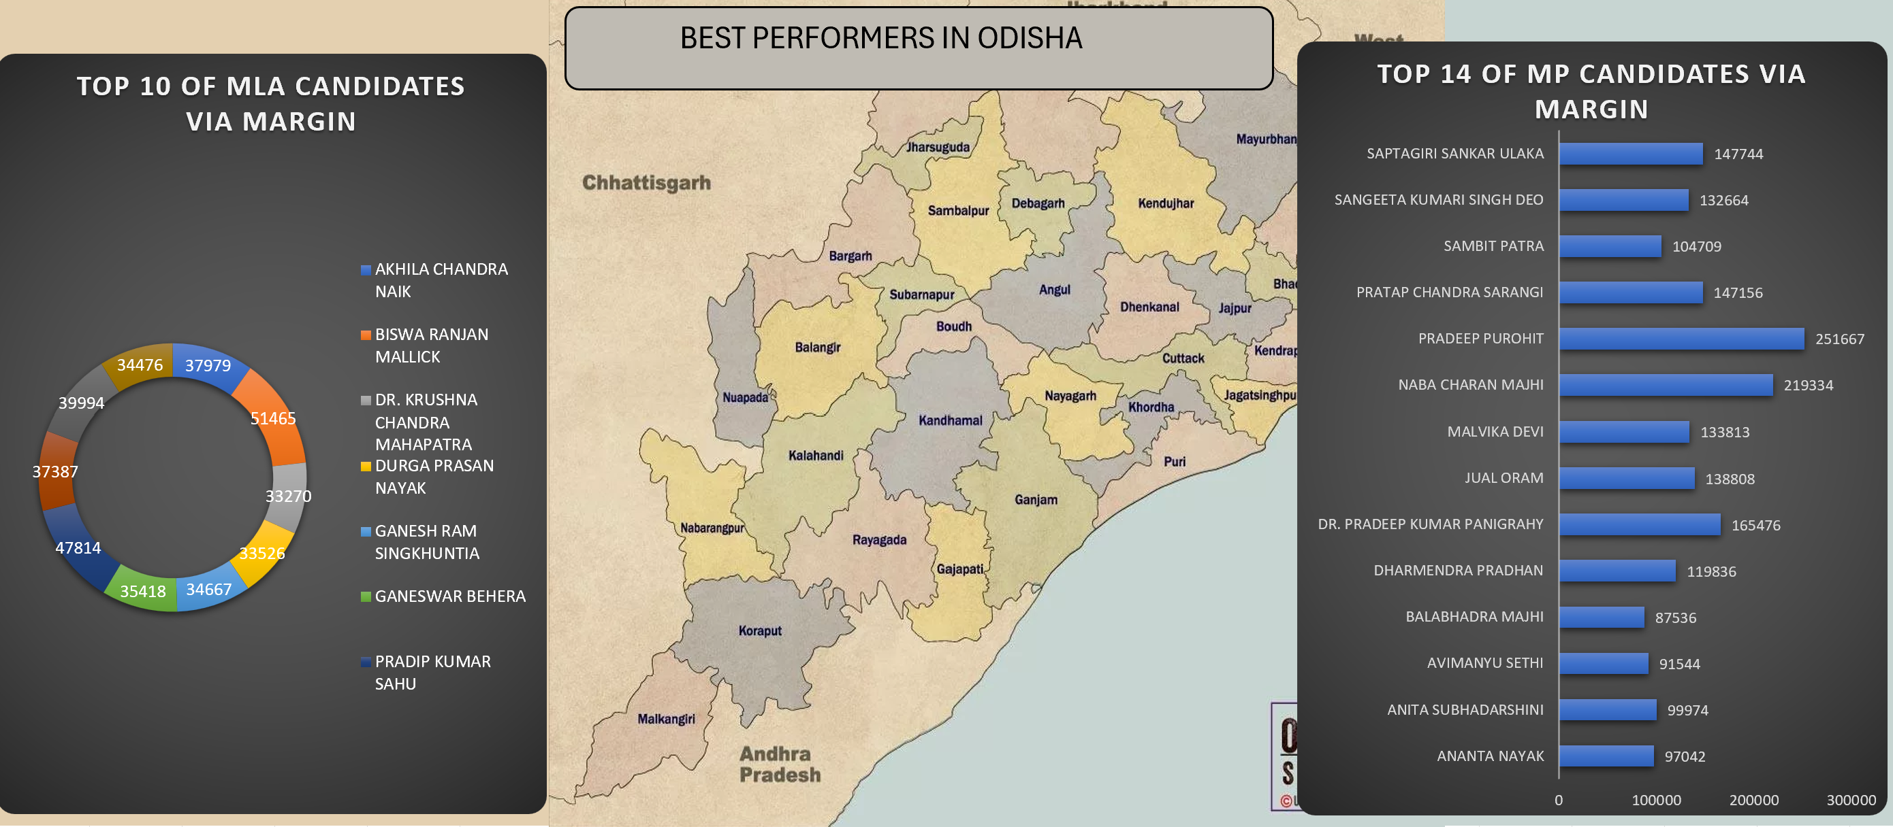
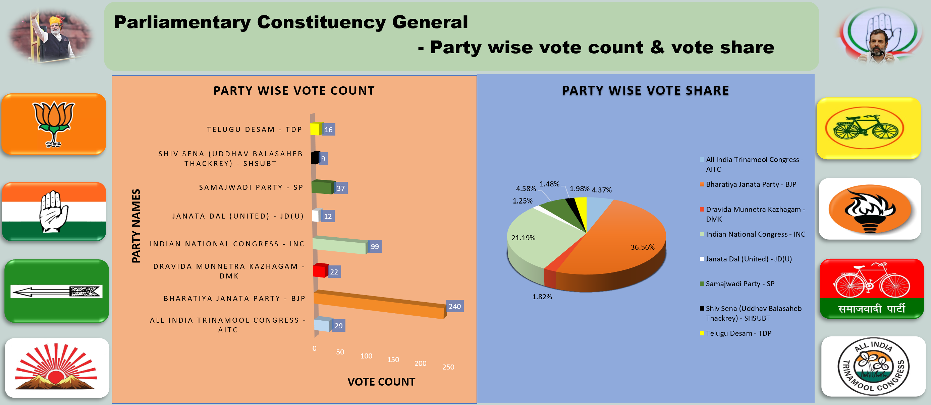
6.DONE ANALYSIS BY CONSIDERING INSIGHTS.

Slide 9

THANKYOU

